Slide 1
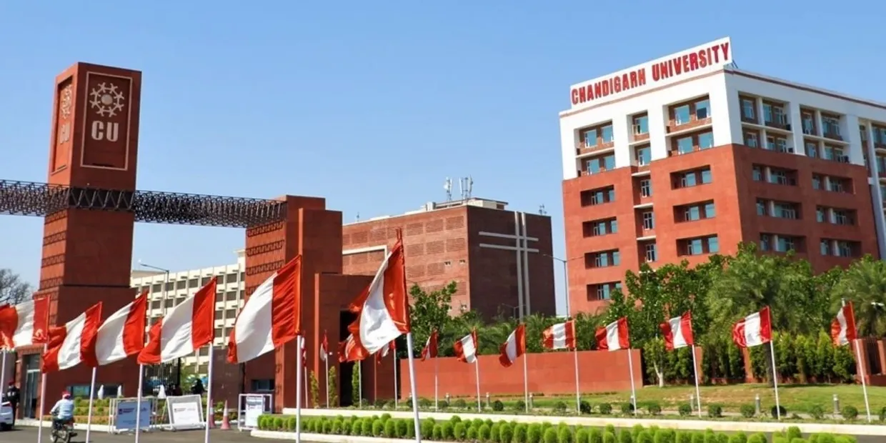
Freshers Fiesta 2025
Welcoming the Next Generation of Scholars
Join us for an unforgettable evening as we celebrate the newest members of our academic community.
Prepare for a night of camaraderie, entertainment, and the beginning of your remarkable journey with us.

Slide 2

Event Overview
Freshers Fiesta 2025 is a comprehensive orientation and integration program designed to welcome new students to Chandigarh University. The event creates meaningful connections between incoming freshmen, returning students, faculty, and administration while establishing a sense of community and belonging.
Date & Venue
Expected Attendance
September 15, 2025
450+ new students
Main Auditorium & Campus Grounds
Faculty & staff participation

Slide 3

Event Objectives
Build Community
Institutional Integration
Foster connections between freshmen and upperclassmen through structured networking and collaborative activities.
Introduce college resources, academic programs, student organizations, and campus facilities to orient new students.
Cultural Exchange
Celebrate diversity through cultural performances, food, and interactive experiences showcasing student talent.

Slide 4
Budget Summary
Total allocated budget: ₹7,01,350
₹2,65,600
₹74,700
Catering & Refreshments
Materials & Logistics
Registration materials, name tags, programs
Food, beverages, and snacks for all attendees
₹1,36,950
Decoration & Setup
Banners, signage, seating, and thematic décor
₹1,73,400
₹49,800
Audio/Visual Equipment
Contingency Reserve
Sound systems, projectors, stage setup, lighting
Unforeseen expenses and adjustments

Slide 5
Detailed Event Budget
Item
Quantity
Rate per Unit
Total Cost
Catering (meals & beverages)
450
₹581.00
₹2,61,450
Audio/Visual rental
1
₹1,49,400
₹1,49,400
Microphones & speakers
4
₹6,225
₹24,900
Decorative materials
1
₹99,600
₹99,600
Staging & lighting
1
₹53,950
₹53,950
Printed materials (programs, name tags)
500
₹99.60
₹49,800
Registration desk setup
1
₹16,600
₹16,600
Contingency buffer
1
₹49,800
₹49,800
GRAND TOTAL
₹7,05,500

Slide 6
Event Timeline & Schedule
8:00 AM
1
Setup & registration desk preparation
2
8:30 AM
Student registration & check-in begins
9:15 AM
3
Welcome address by Principal & Dean of Students
4
9:45 AM
Campus facility tour in guided groups
11:00 AM
5
Student organization showcases & interactive booths
6
12:30 PM
Lunch & informal networking
1:30 PM
7
Cultural performances & talent showcase
8
3:00 PM
Closing remarks & group photo

Slide 7
Participant Information System
Comprehensive participant database for event management and follow-up communications.
Name
Course/Branch
Contact Number
Status
Aarav Sharma
Engineering (CSE)
+91-98765-43210
Confirmed
Priya Desai
Commerce
+91-87654-32109
Confirmed
Arjun Patel
Liberal Arts
+91-76543-21098
Confirmed
Kavya Singh
Engineering (ECE)
+91-65432-10987
Pending
Ananya Gupta
Sciences
+91-54321-09876
Confirmed
Rajesh Kumar
Business
+91-43210-98765
Confirmed
Database continues with 444+ additional participant records maintained for event coordination and post-event engagement.

Slide 8


Formal Invitation
Chandigarh University
Office of Student Affairs
Dear Honored Faculty, Staff, and Student Leaders,
Chandigarh University
You are cordially invited to participate in Freshers Fiesta 2025, our signature orientation and integration program welcoming the incoming class of first-year students Chandigarh University.
Formal Invitation Letter
Event Details:Date: September 15, 2025Time: 8:30 AM – 3:30 PMVenue: Main Auditorium & Campus Grounds
This event celebrates the beginning of an exciting academic journey and strengthens our college community. Your participation as mentors, volunteers, and leaders is essential to the success of this initiative.
Please confirm your attendance by September 8, 2025.
Warm regards,Event Coordination CommitteeOffice of Student AffairsChandigarh University

Slide 9




Event Success Metrics
Measurable outcomes demonstrating program effectiveness and impact on student integration.
95%
85%
Anticipated Attendance Rate
Satisfaction Rating
Target participation from registered freshmen
Target post-event survey satisfaction
80%
90%
Student Organization Engagement
Community Connection
Join rate for clubs and societies
Students reporting new campus friendships

Slide 10

Thank You
Freshers Fiesta 2025 represents our commitment to fostering an inclusive, connected and vibrant college community where every student feels welcomed and valued.
For More Information
Contact: Office of Student AffairsEmail: studentaffairs@cuchd.inPhone: +91-172-267-4567
Chandigarh University – Building Leaders, Creating Futures

